Slide 1
Introduction to Tableau

Slide 2
Objectives
Basic Terminology
Components of SQL
Data Description Language
Data Manipulation Language
Clauses
Aggregate Functions

Slide 3
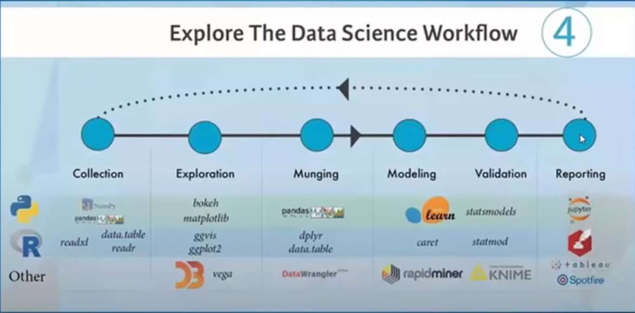
Data Science Workflow

Slide 4

Data Visualization
Visualization allows us visual access to huge amounts of data in easily digestible visuals.
Well defined data graphics are usually the simplest and at the same time, the most powerful

Slide 5
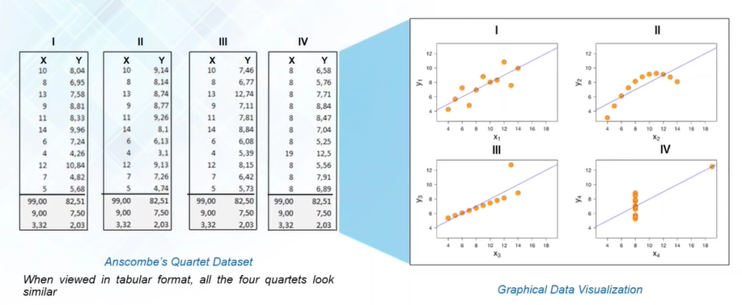
Power of Visualization

Slide 6

What is Tableau ?
A business intelligence and data visualization tool allowing users to make sense of their data through interactive charts, graphs, and diagrams.

Slide 7

Why learn Data Visualization/Tableau
Easier to get the insights from the data
Better customer relationship
Powerful, easy to use and attractive

Slide 8
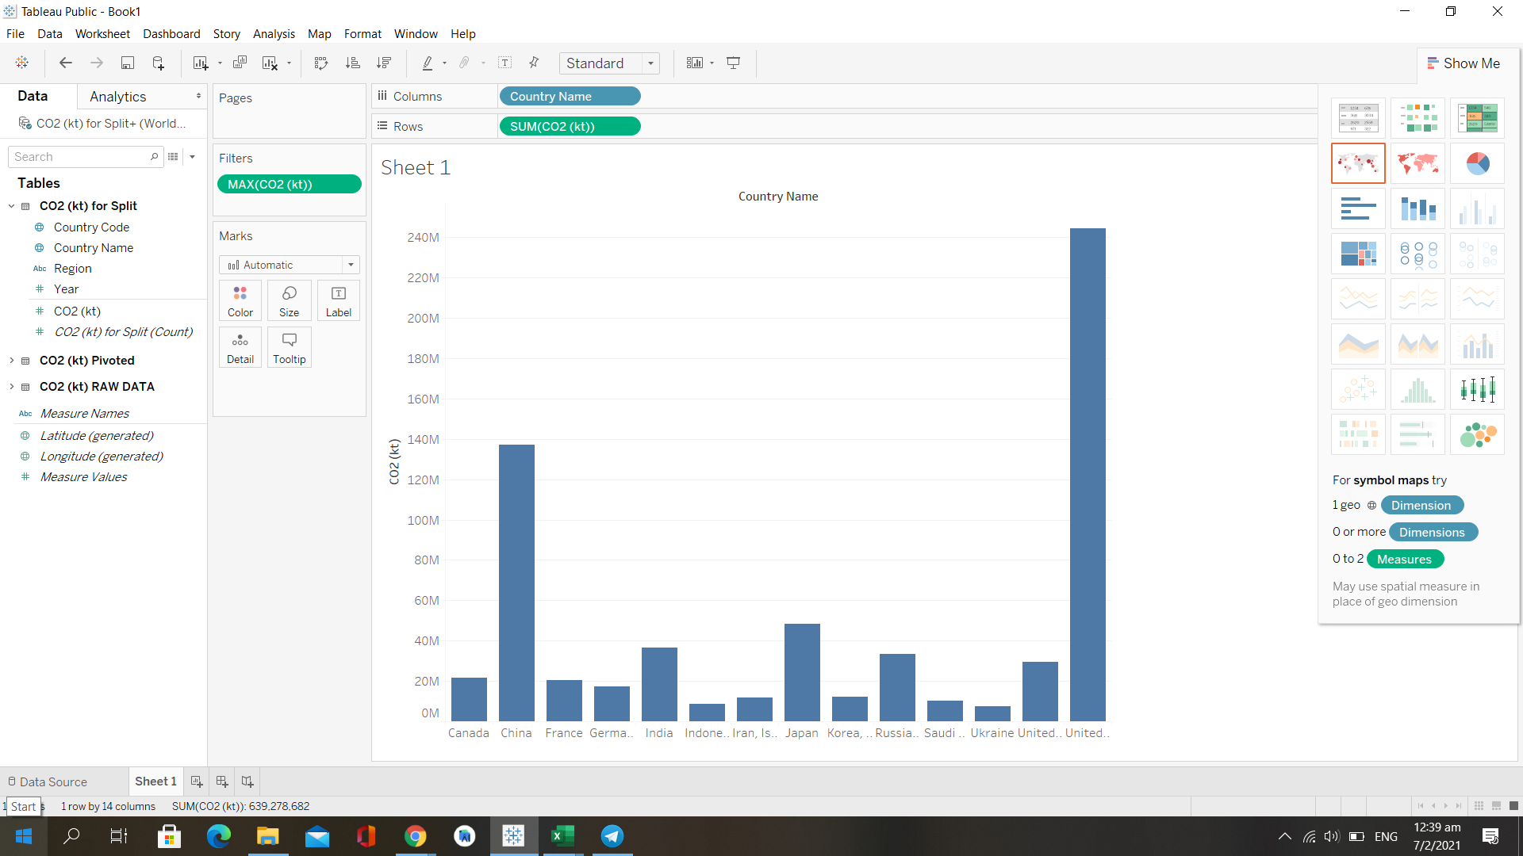
Tableau Desktop - Drag & Drop

Slide 9
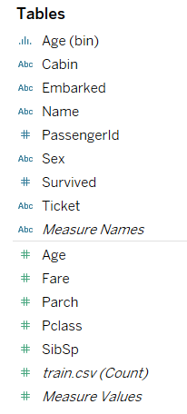
Dimensions and Measures
A dimension is a field that is an independent variable.
A measure is a field that is a dependent variable and its value is a function of one or more dimensions.

Slide 10
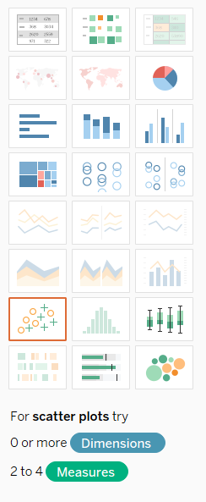
Tableau’s friendly UI

Slide 11

Let’s get started!!!

Slide 12
To see how many people boarded Titanic with respect to their age
Duplicate age
Convert age to dimension by clicking the arrow
Drag age to the column section
Drag train.csv(Count) to rows

Slide 13
To see how many people boarded Titanic with respect to their age
Duplicate age
Convert age to dimension by clicking the arrow
Drag age to the column section
Drag train.csv(Count) to rows
Observations: there are a lot of values which are defined as null

Slide 14
How to remove null values from your graph
Hold CTRL button and drag your age (dimension) to filters
Unselect null values and apply

Slide 15
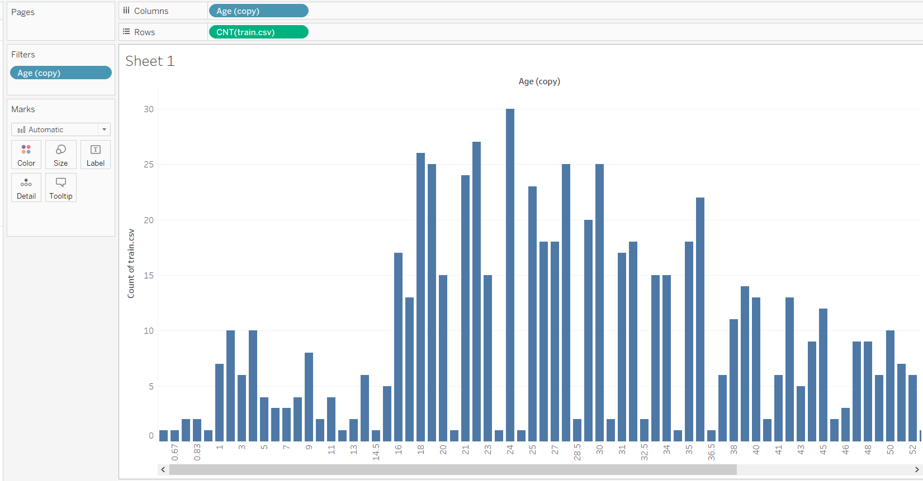

Slide 16
To see how many people boarded Titanic with respect to groups of ages
This is different form the previous task as we will be visualizing the data with groups of ages
Click on arrow for age and select create -> bins
Size of bin = 10
Drag age (bin) to columns
Drag train.csv(count) to rows
Repeat the steps with age(bin) to remove null values

Slide 17
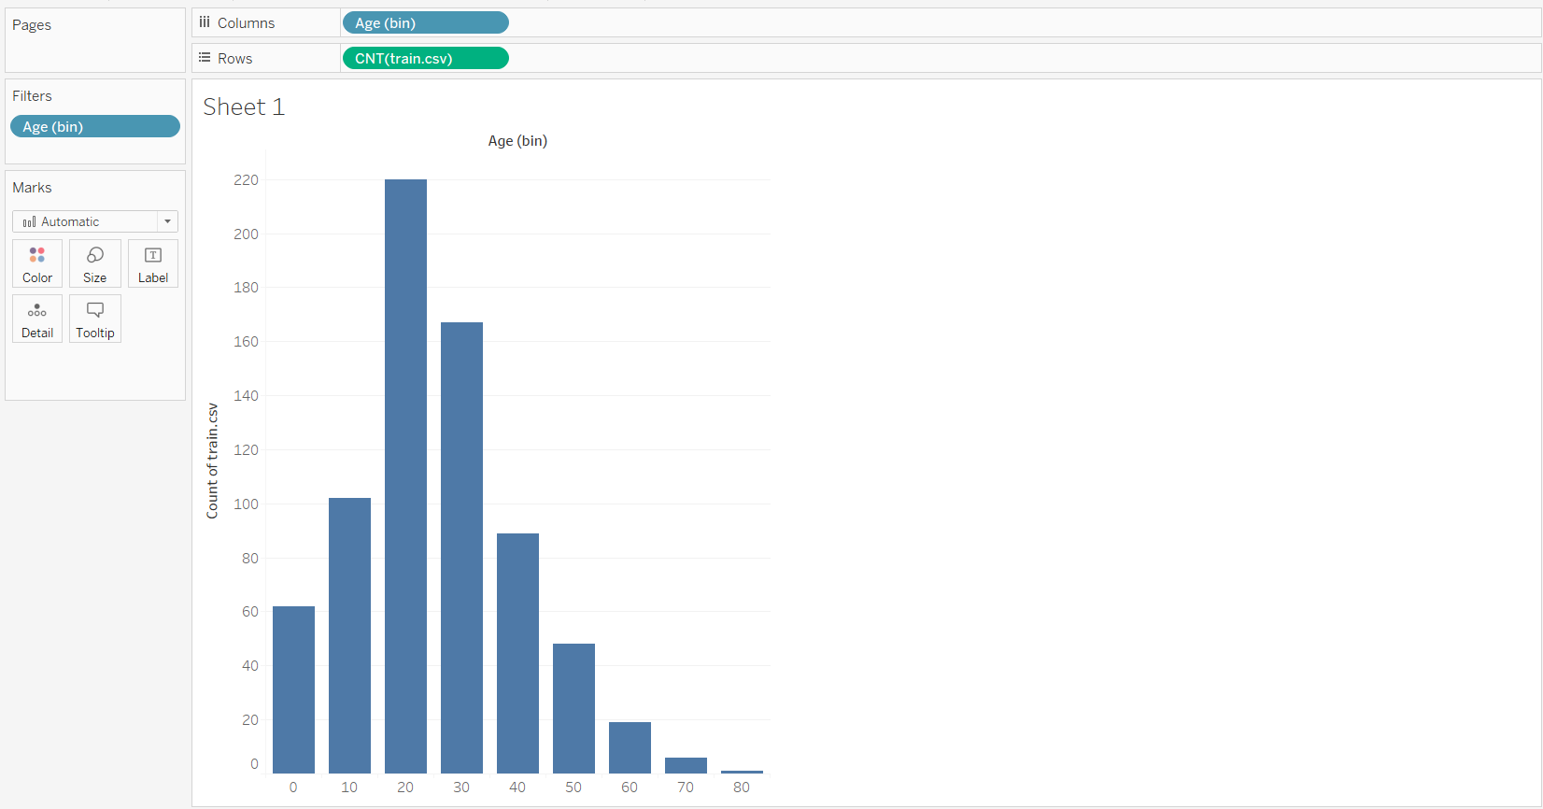

Slide 18
To see how many people boarded Titanic with respect to groups of ages with percentage
Follow the steps in the previous slide
Drag no.of records to rows
Click on the arrow -> quick table -> percent of total

Slide 19
To add labels to the graphs
Hold CTRL and drag CNT(train.csv) (without % in total) present in the rows to the labels section below Marks under the column below All
Hold CTRL and drag CNT(train.csv) (with % in total) present in the rows to the labels section below Marks under the last column

Slide 20
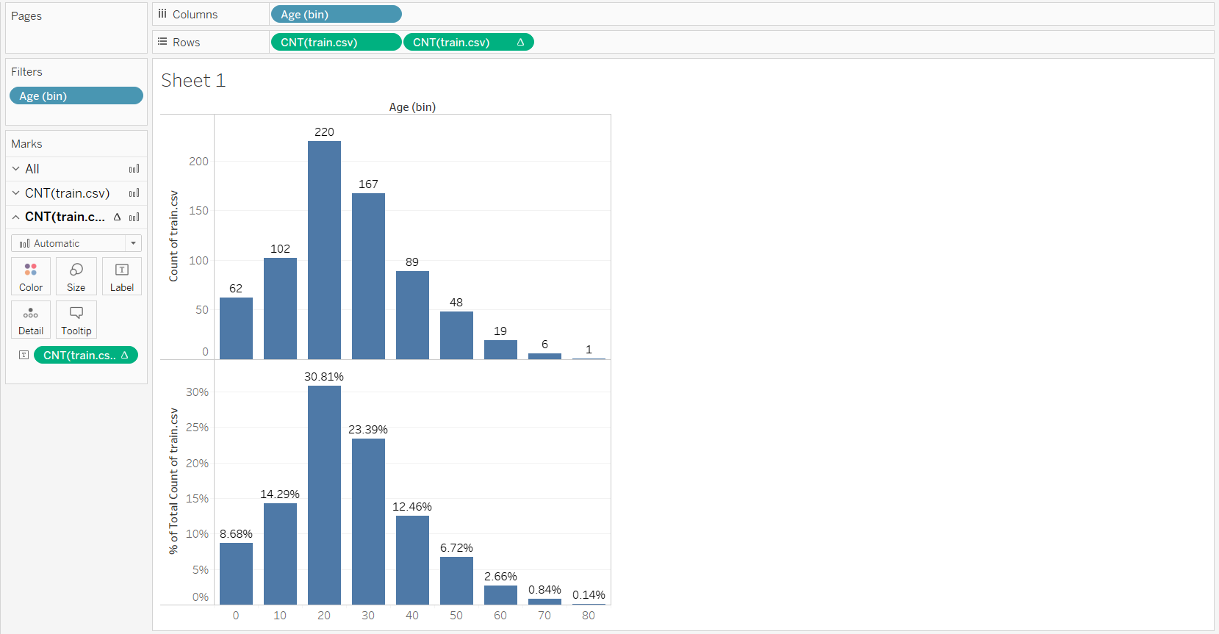

Slide 21


Slide 22
You may be having doubts about this workshop
Why am I learning about creating such simple graphs and adding labels when I can do this on excel
The answer to this question is , tableau is very powerful (we have not seen its true potential yet)
Able to compute graphs and difficult calculations within seconds
Easy to create interactive dashboards
Pretty 💁‍♂️💁‍♀️

Slide 23
To see how many people survived the Titanic
Convert survived to a dimension
Drag survived into color section in the table marks under All section

Slide 24
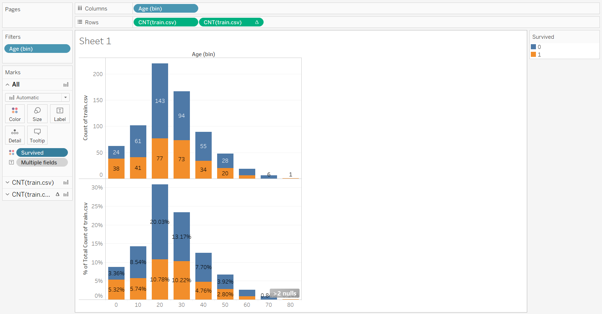

Slide 25
To see how many people survived the Titanic
Convert survived to a dimension
Drag survived into color section in the table marks under All section
Observation: At the right bottom of the page, it signals that there are a few null values, survived column in the dataset may have null values. You can remove them to get an accurate graph

Slide 26
To see how many people survived the Titanic
Convert survived to a dimension
Drag survived into color section in the table marks under All section
Observation: At the right bottom of the page, it signals that there are a few null values, survived column in the dataset may have null values. You can remove them to get an accurate graph

Slide 27
To observe the data of how many people survived
Drag survived to columns
Drag number of CNT(train.csv) to rows

Slide 28
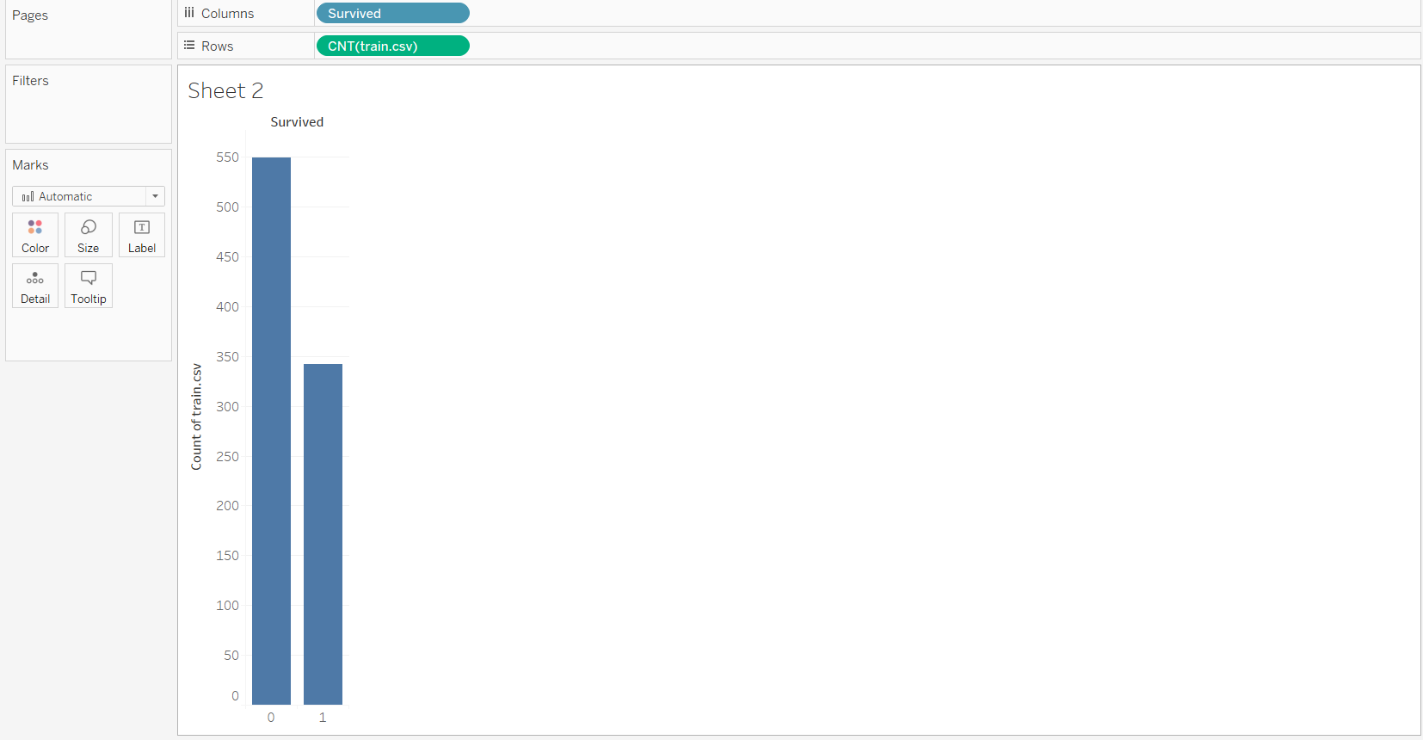
BORING!!!

Slide 29
To observe the data of how many people survived
Drag survived to columns
Drag number of records to column
Click on show me
Select pie chart
CTRL + drag survived and CNT(train.csv) to label under marks

Slide 30
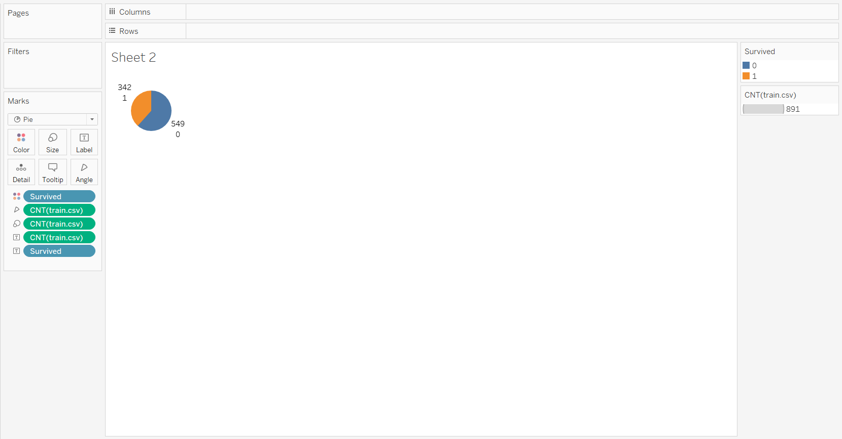
BETTER🙌

Slide 31
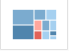
Lets try visualizing the number of people who boarded the titanic with groups of ages with a different type of graph
Click on arrow for age and select create -> bins
Size of bin = 10
Drag age (bin) to columns
Drag train.csv(count) to rows
Repeat the steps with age(bin) to remove null values
Click on show me and click this option

Slide 32
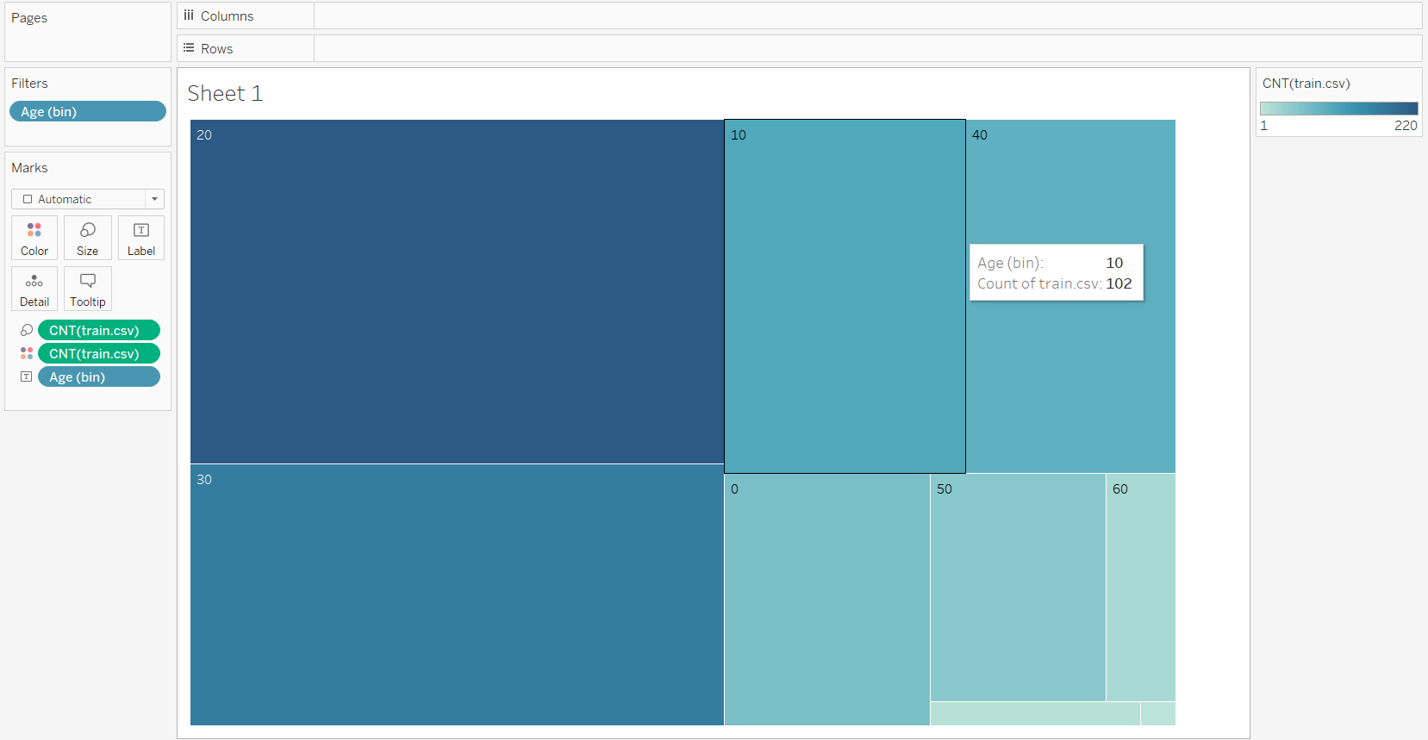

Slide 33
To create a calculated field for identifying child and adult
Click on the arrow for ages
Choose create -> calculated field
Name the field child-adult
In the calculation, write
If [Age] <18 THEN ‘Child’ ELSE ‘Adult’
END

Slide 34
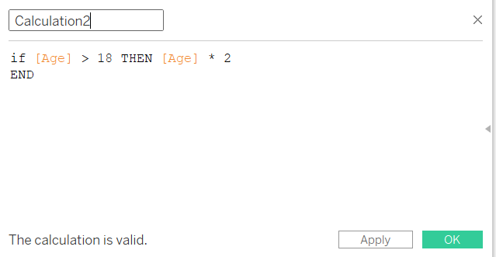
To create a calculated field by doing calculations

Slide 35
Exercise: To create a graph to identify the the number of passengers who were child or adult and whether they survived

Slide 36
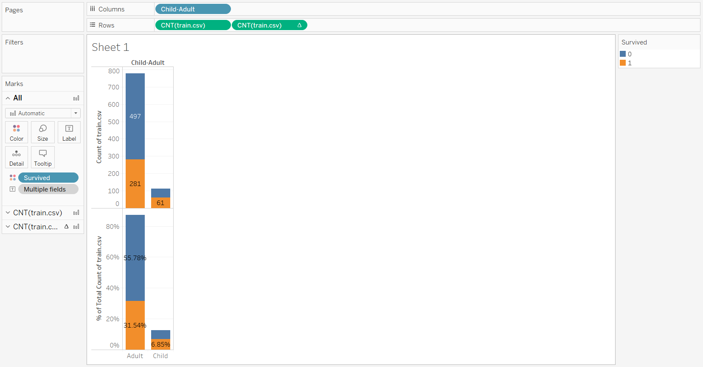
Answer:

Slide 37
To create a dashboard
You should have multiple sheets
Click on new dashboard at the bottom of the screen
In your new dashboard, select the sheets you want to include in your dashboard
Move your sheets around to get a suitable arrangement for your data visualization

Slide 38
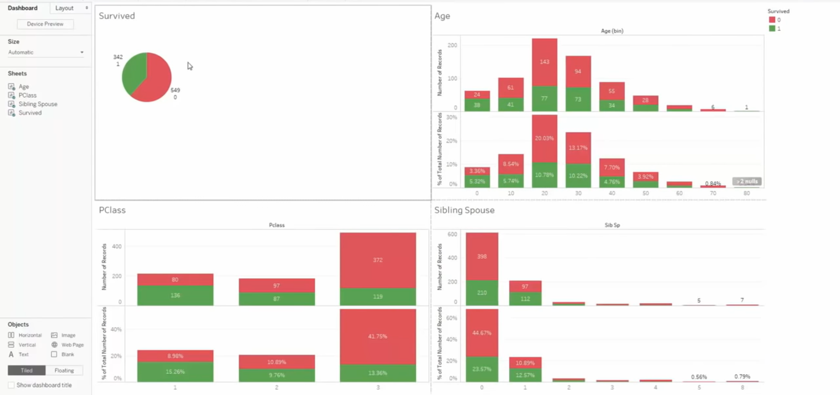

Slide 39
Practice questions
Does the class of the passenger affect the survival rate of the passenger? Create a suitable graph to explain your reasoning
Calculate and graph the total amount of money earned by tickets sold to people who are younger than 50 and people who are older than 50 which costs $500 and $400 respectively. Make a graph to compare the amount of money earned through the different age groups.
Explore other types of graphs!

Slide 40


Slide 41



Join us at the IES Student Chapter @ SUTD
Telegram
Channel
IES SUTD
Membership
Official IES
Membership

